Slide 1
Top Movies 2018
By Eric and Kevin

Slide 2
Top Movies of 2018
How do DVD / Blu ray sales correlate with revenue
Best Performing categories in 2018
Best and Worst months for movies in 2018
Proportion of total revenue from DVD / Blu ray sales

Slide 3
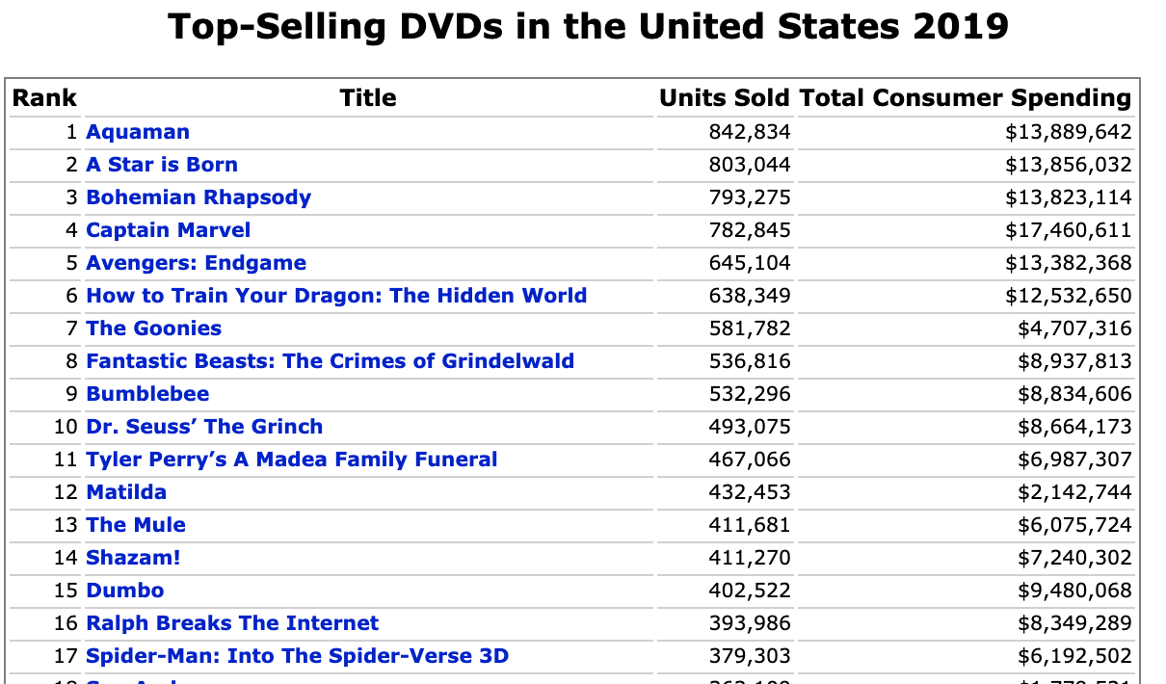
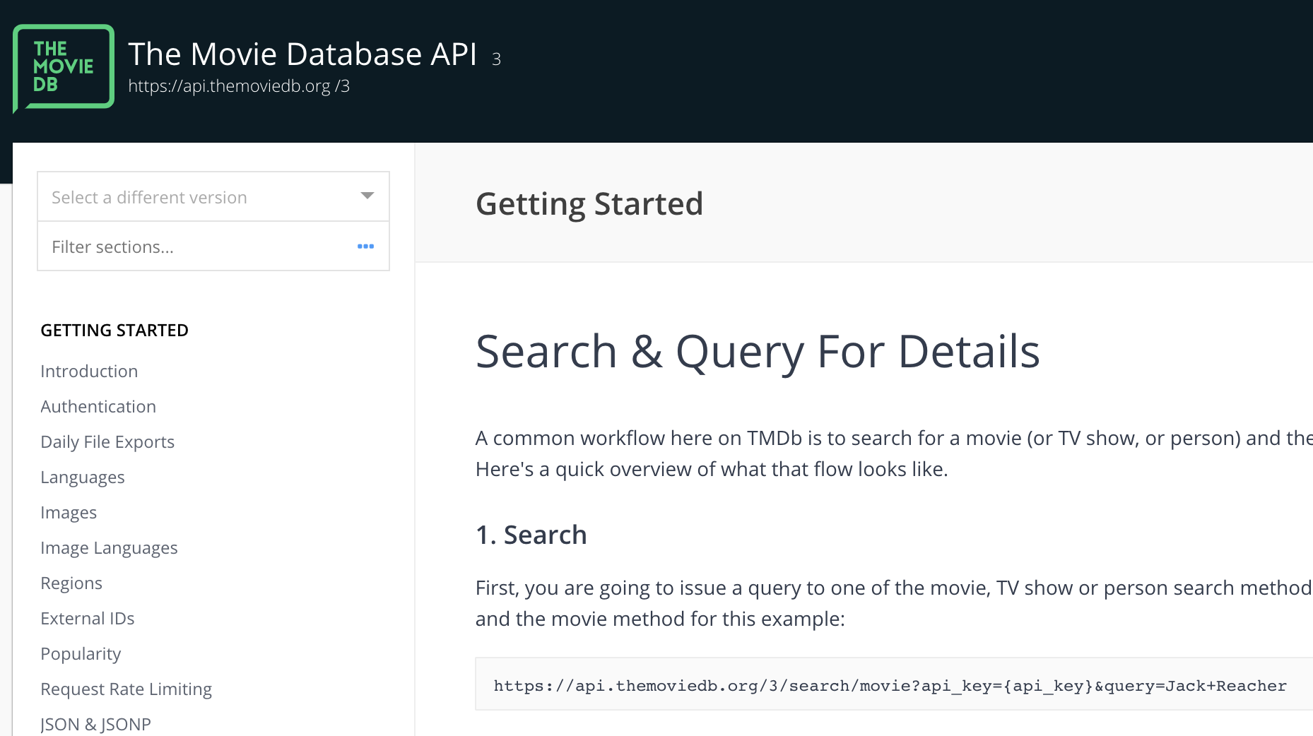
Data Sources
The-numbers.com
The Movie DB

Slide 4
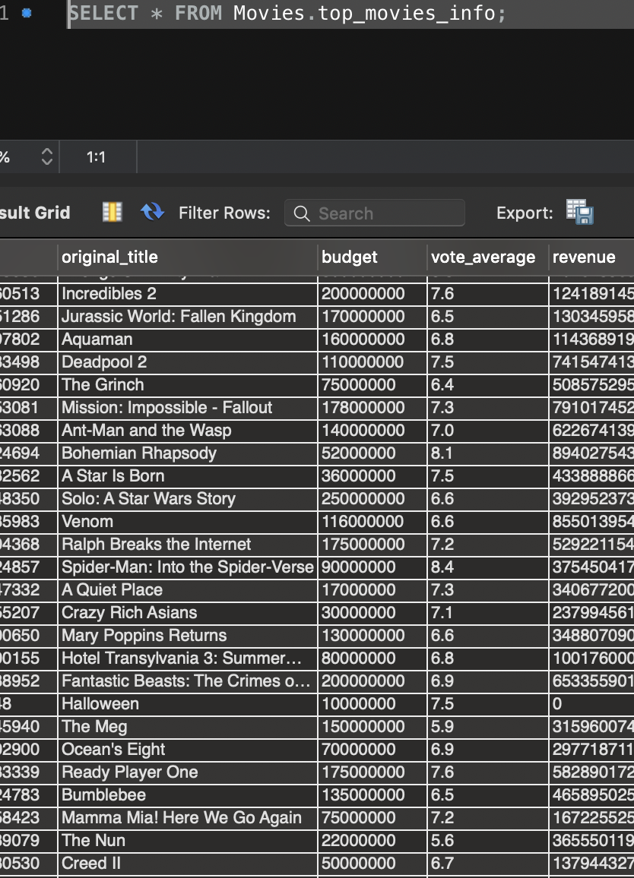
The Process
Web Scrape the-numbers.com
The Movie DB API
Create and commit to SQL AWS DB
Query Results
Make Beautiful Charts

Slide 5
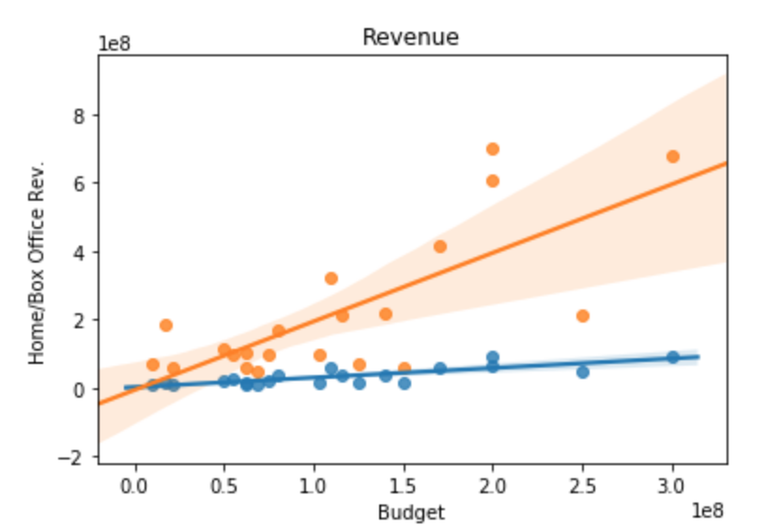
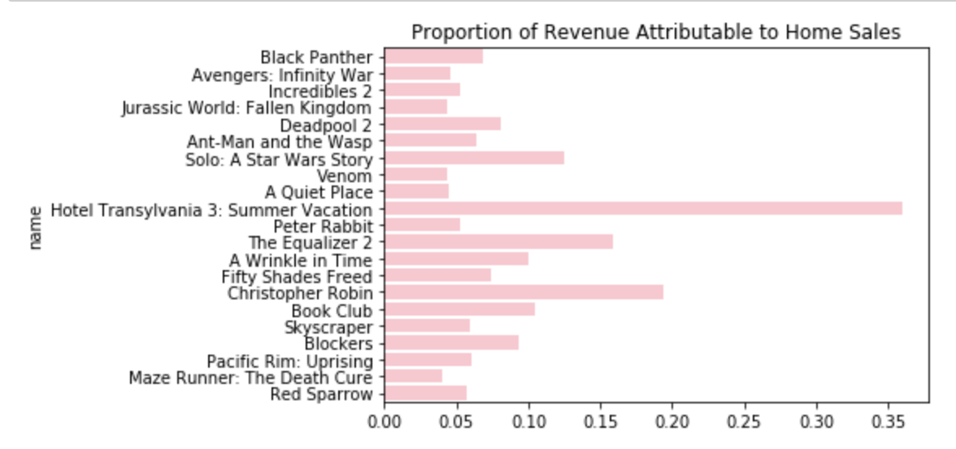
DVD / Blu Ray
Bar Color:
Home Sales: Box Office Sales:

Slide 6
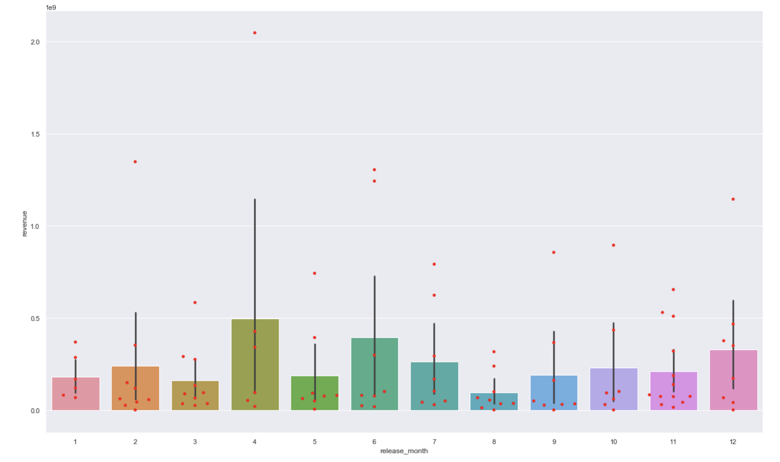
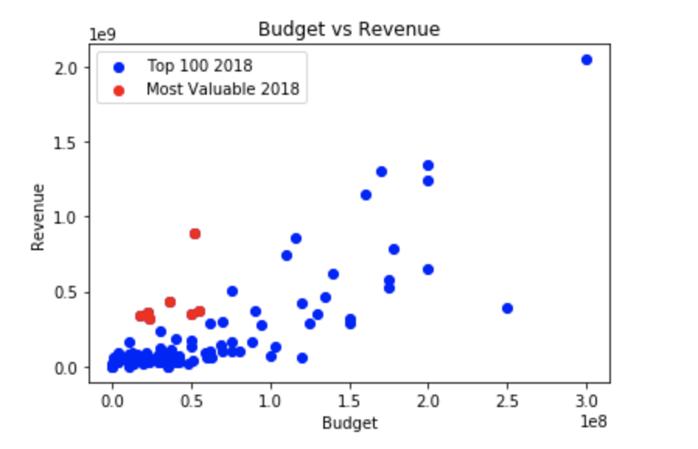
Top Movie Data

Slide 7
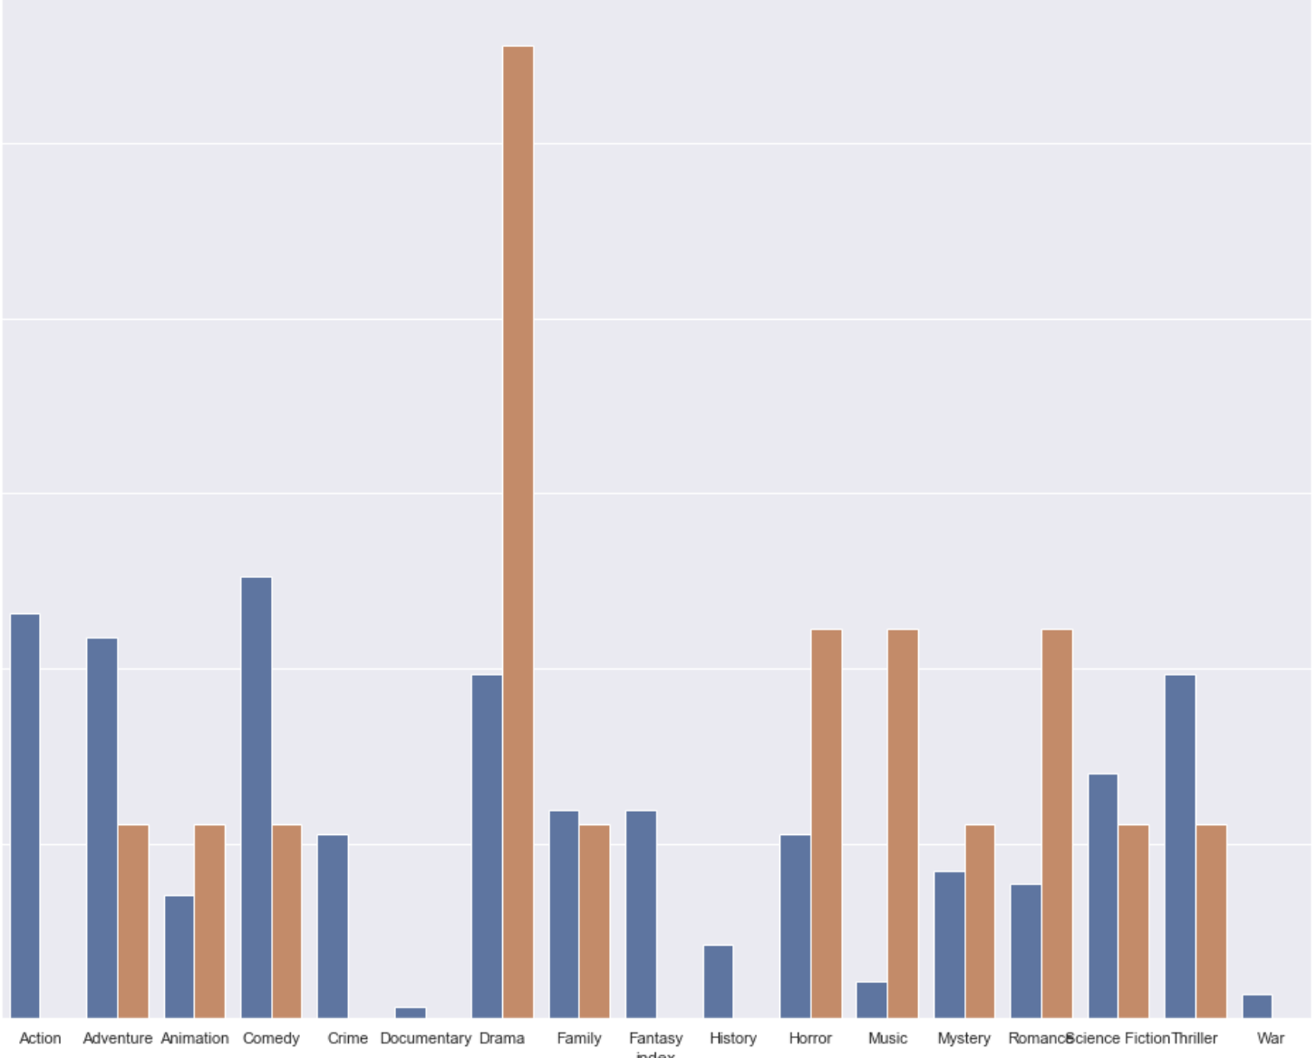
Most Profitable Genre
Top performing movies:
Top 100 movies

Slide 8

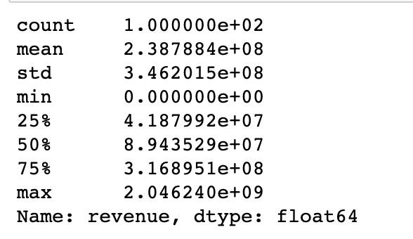
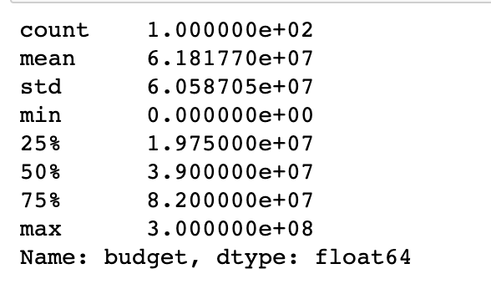
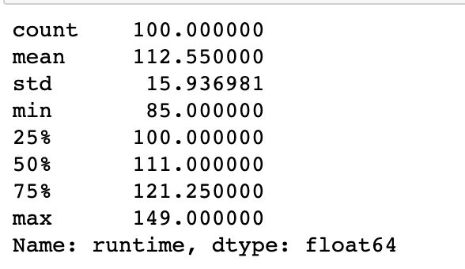
Summary Statistics
Revenue Budget Runtime

Slide 9
Actionable Insight
Profitable Categories
Drama and Music
DVD / Blu ray Sales
Save your budget

Slide 10

Thanks!

